Slide 1
Game Programming

Slide 3
Player Feedback

Slide 4
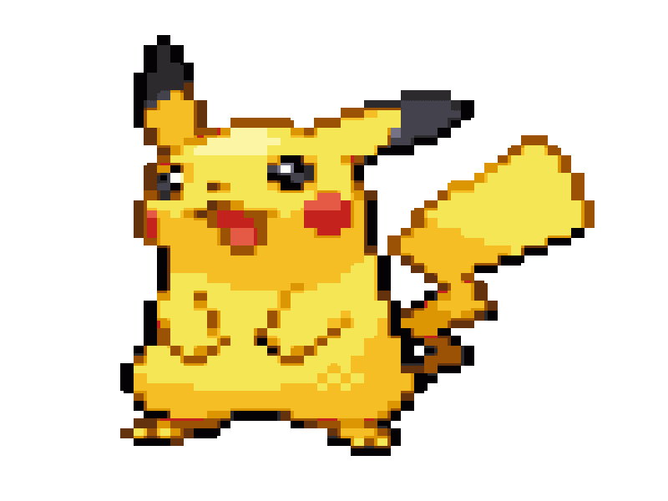
Voorbeelden
Player Feedback
Link naar voorbeelden van effects
Notes:
https://www.youtube.com/watch?v=bBQ9C2G3BFY

Slide 5
Welke vormen van playerfeedback herkennen we?
Player Feedback
Fortnite
https://www.youtube.com/watch?v=Q19apeXtGXE
Apex
https://www.youtube.com/watch?v=mH8v3Q5amuk
Minecraft
https://www.youtube.com/watch?v=K8sPIioq-e4

Slide 6
Playerfeedback in Tower Defense games
Player Feedback
Veranderen van score
Aangeven van pad
Notes:
https://youtu.be/K2ObESxQbPY?t=405

Slide 7
Particles
Particles
ParticleSystems
Oneshots
Instantiating van Particles

Slide 8
Player Feedback

